Slide 1
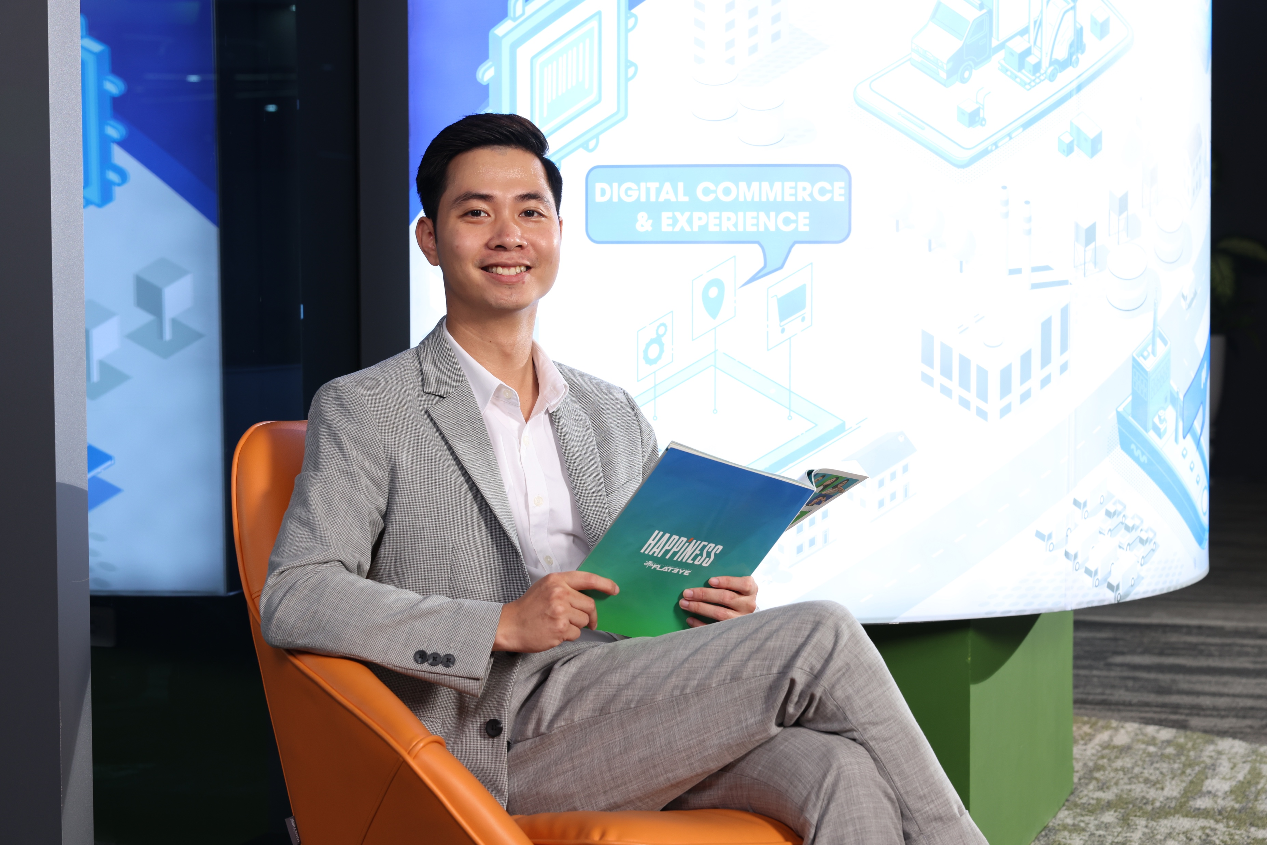


Luu Quoc thang
I am a dedicated and highly adaptable software engineer with experience in Python development, specializing in Flask and Django frameworks. With a solid foundation in backend architecture and full-stack capabilities, I excel in delivering scalable and maintainable solutions for complex business requirements. I am passionate about continuous learning, applying clean code principles, and building systems that make a real impact. I actively collaborate with customers to define UX/UI foundations and ensure the delivery of clean, scalable, and maintainable systems under Agile Scrum methodology..
Experienced with Python, Django, FastAPI, Flask.
Experienced with Java, Java Spring, NodeJS.
Experienced with Azure Cloud
Frontend familiarity: ReactJS, HTML5, CSS3, JavaScript, Bootstrap.
Strong database skills: PostgreSQL, MySQL, SQL Server, MongoDB
Experienced with Microservices, RESTful APIs, Message Queues (RabbitMQ, Kafka)
CI/CD experience: GitHub Actions, GitLab CI/CD, Jenkins
Good understanding of design principles and scalable architecture
Skilled in debugging, unit testing, logging, and monitoring systems
Design and implement scalable system architectures and project structures, develop and review code, manage code merges, unit testing, and bug fixes
Manage, assign task, estimate, make plans, design solution and review code for members.
Senior Software Developer
With 8 years of experience in software development, including 3 years as a software engineer and 5 years in technical leadership at FPT Software. I have developed deep expertise in both Python and Java, as well as front-end technologies like HTML, CSS, JavaScript, Vue, and React.
I have 2 years of experience teaching Python and Machine Learning for FPT Academy
Programming Languages: Python (Adv.), Django (Adv.), Java (Adv.), Spring (Adv.) NodeJS (Int.)
Additional : AWS Cloud (Int.), Postgres (Adv.), Oracle (Int.), Microsoft SQL Server (Int.), MySQL (Int.)
Front-end Angular(Int.), ReactJS(Int.), Vue (Adv.), HTML (Adv.), CSS (Adv.)
Bachelor of Engineering
thanglq4@fpt.com

